Slide 1
An Introduction to
Romano-British Pottery
Jonathan Dicks

Slide 2
Objectives
An overview of the major pottery types found in Hampshire and Sussex
An appreciation of what pottery can tell us about Romano-British life
To obtain some practical experience

Slide 3
Time Table
10:00 – 12:30 Why is pottery important?
    Fabric and Form
    Major kilns
12:30 – 1:30 Lunch
1:30 – 3:30 Practical session
      Pottery Identification
3:30 – 4:00 Case Study
        Villa Life

Slide 4
Why is pottery important?
The majority of artefacts recovered from excavations are pottery
Pottery survives whereas other materials are destroyed
It is dateable and can be used to date sites and buildings
It can indicate the life style of a site (socio-economic structure)
Pottery can help in understanding trading patterns that existed during the Roman occupation

Slide 5
Pottery as a dating tool
Vessels changed over time much as fashions change today
Cannot be dated directly but by association such as:
  Coin evidence
  Historically dated incidents such as
    Boudiccan uprising
    Vesuvius
    Hadrian’s Wall
    Antonine wall

Slide 6
Pottery as a dating tool
Vessels changed over time much as fashions change today
Cannot be dated directly but by association such as;
  Coin evidence
  Historically dated incidents such as
    Boudiccan uprising; AD 61
    Vesuvius; AD 79
    Hadrian’s Wall AD 122
    Antonine wall; AD 159-160

Slide 7
Dates
Pre-Flavian pre- AD 70
Flavian AD 70-100
Trajanic AD 100-120
Hadrianic AD 120-140
Antonine AD 140-200

Slide 8
Romano-British Pottery
Localised Iron Age pottery already being produced
The Romans introduced many new forms and many different shapes
Improvements in kiln technology
Pottery was traded for money
Specialisation of trades
Saxons were not into mass production

Slide 9
‘The life of a pot’
Manufactured
Distributed
Used
Discarded
Post-depositional deterioration
Re-deposition
Archaeological recovery

Slide 10
The Life of A Post Hole
New Forest Jug
1524
Packing Stones
1525
1526
Samian Mortaria
Drag 45

Slide 11
Manufacture
Hand made
  Table turned or Wheel thrown
  Moulded
Kiln or Bonfire
Small or large scale production
  Household
  Nucleated Workshops
  Factory

Slide 12
Manufacturing Process
Clay preparation
Formed
Dried
  Green or leather hard
Decorated
  Slipped
  Burnished
  Painted
Fired

Slide 13
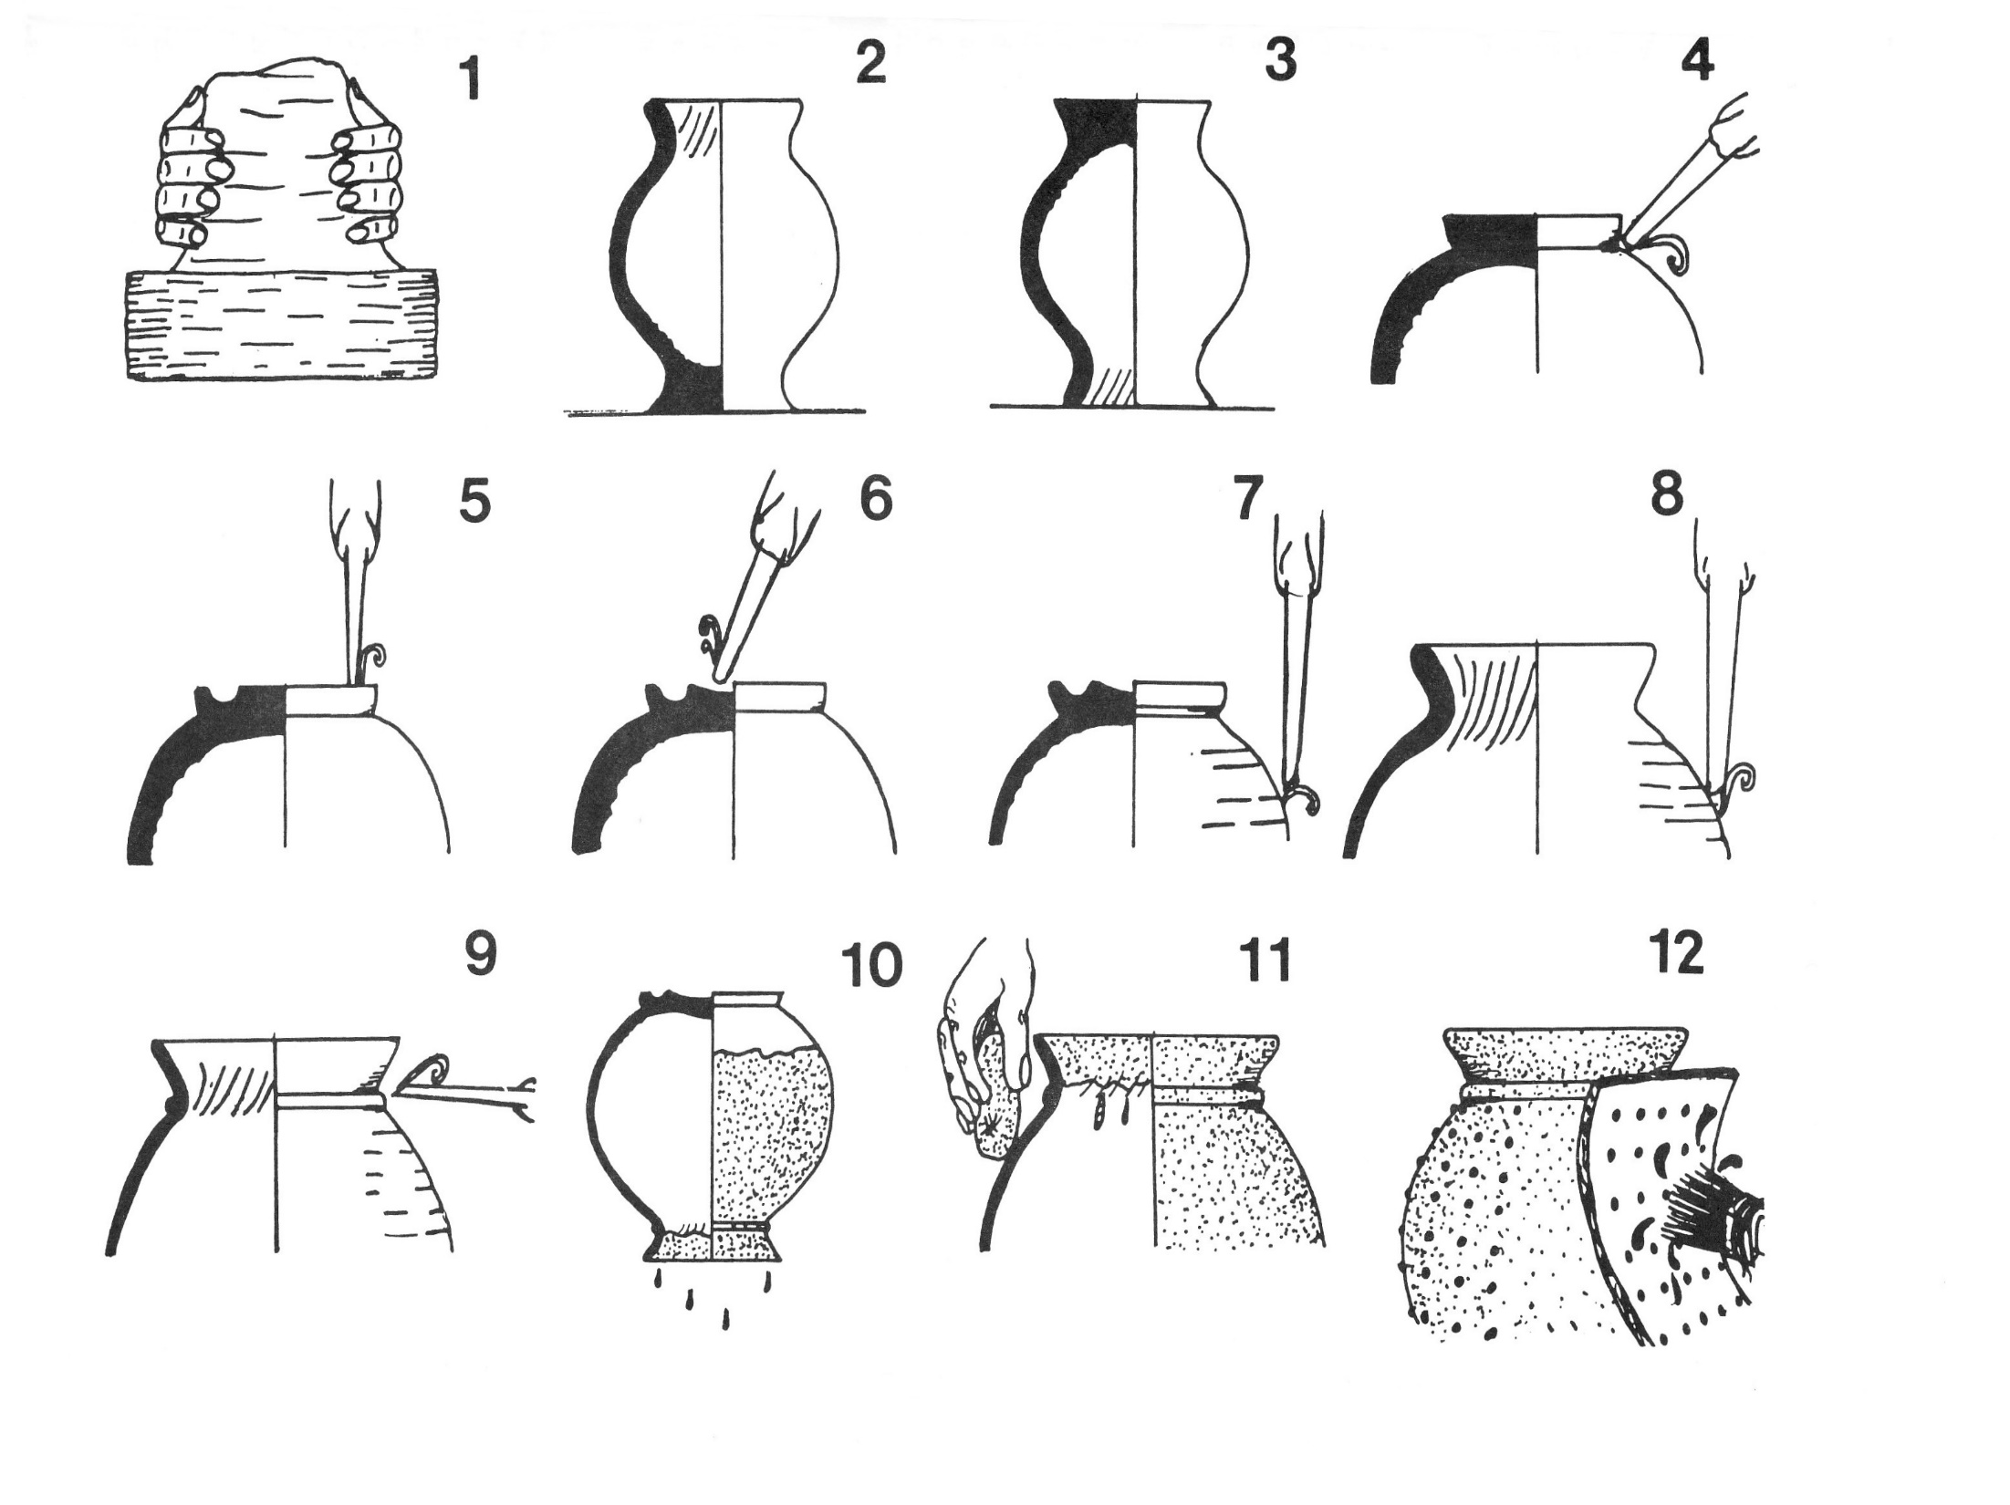

Slide 14
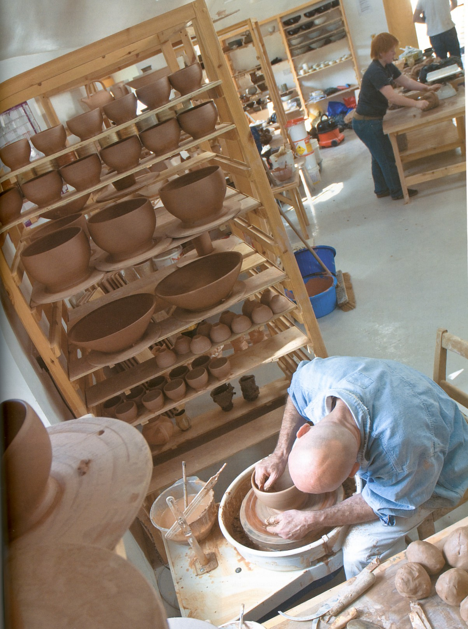

Slide 15
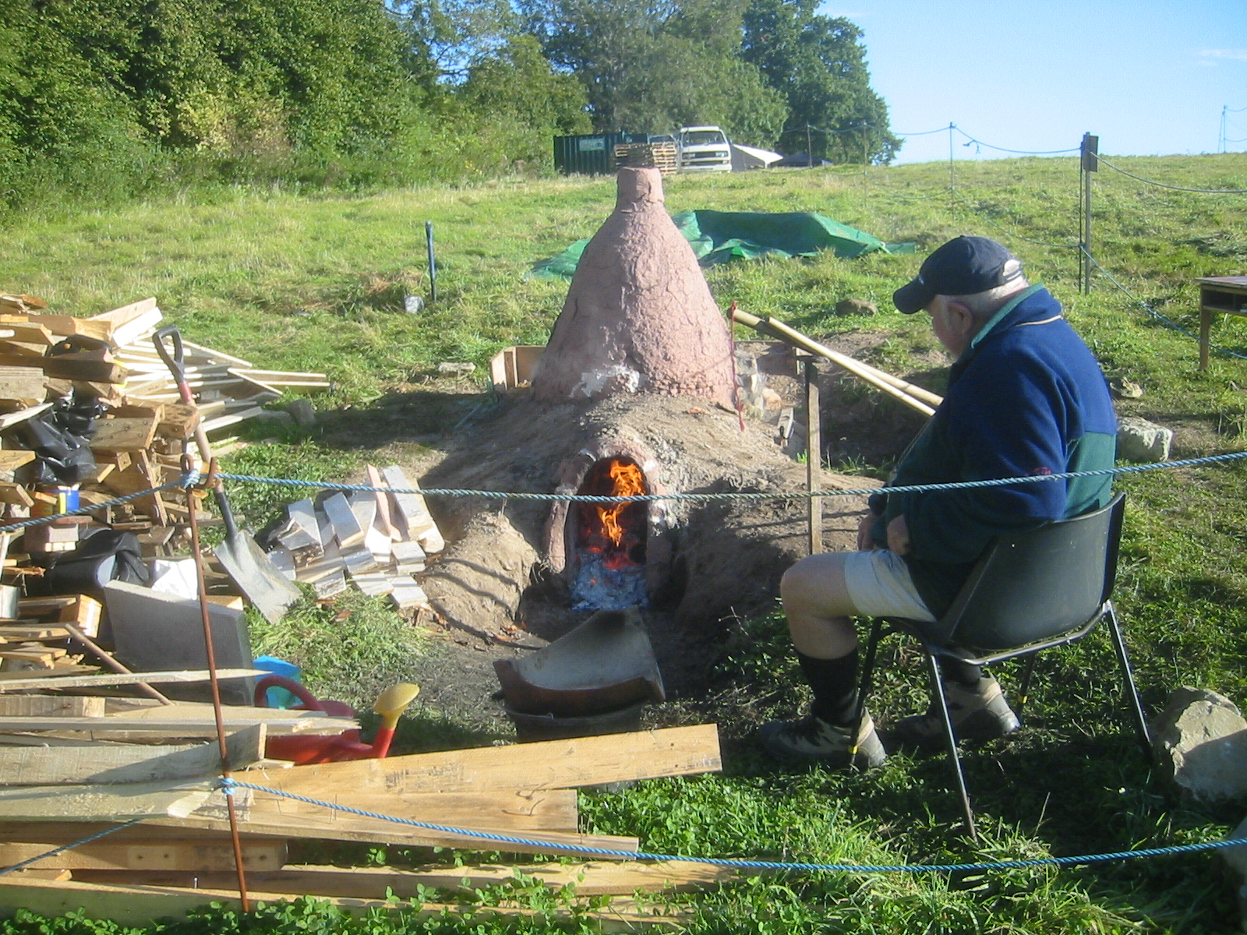

Slide 16
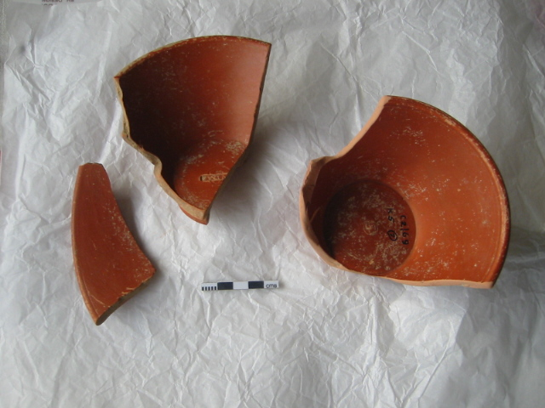
Let’s have a break

